Slide 1
Mapping Tectonics with LIDAR
With contributions from GETSI-SERC (Bruce Douglas, Gareth Funning)

Slide 2
Topography and LIDAR

Slide 3
Topography in the Modern Era
Topographic mapping is now an automated, remote sensing process, using the distortions obtained in satellite or air photos with oblique viewing angles.
A digital elevation model (DEM) is the modern equivalent of a topographic map, with elevation information gridded into pixels.
By shading the topography artificially (“hillshading”), you can identify more details than are visible from the heights alone.
Airborne and terrestrial lidar systems produce a significantly higher density of measurements and can permit the removal of vegetation from the DEM.
Notes:
General comments about the evolution of ways in which we display topographic information in a 2-D fashion

Slide 4
Digital elevation models
“A DEM is a digital data set, a grid of numbers representing the elevation of the surface, sampled at a regular spacing, and with known coordinates.”
How are DEMs created?
From older (triangulation/clinometry) and newer optical photo-based methods of topographic data sets used to construction topographic maps
DEMs from optical satellite images
Lidar
Notes:
Definition of the acronym DEM with various means of creating these types of products. Since this presentation focuses on LiDAR, details of the latter are given in subsequent slides.

Slide 5
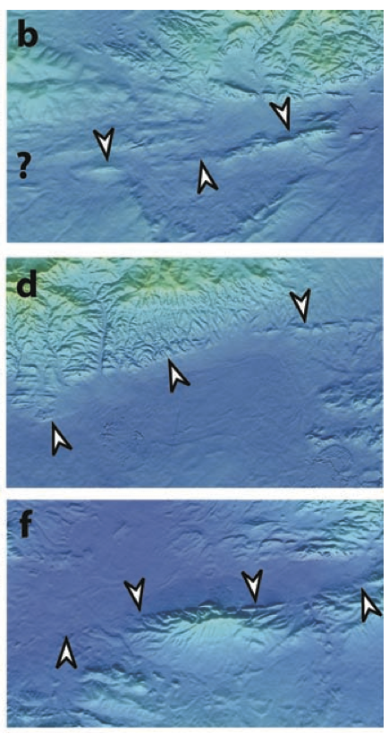
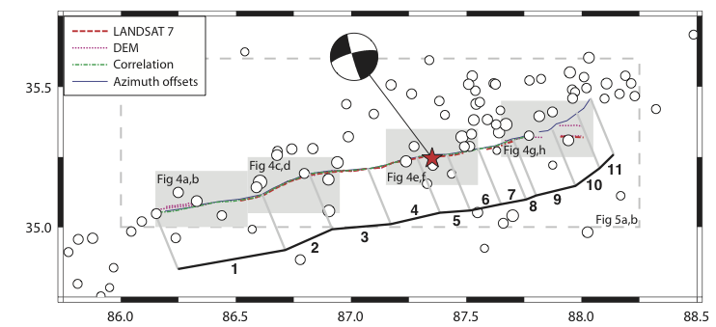
Uses of DEMs
Fault geomorphology (in Tibet)
Funning et al., 2007
Notes:
Example of how the use of a hillshaded relief image can reveal subtle topographic details, in this case a fault scarp that is associated with an active fault.
Image source: G J Funning, B Parsons and T J Wright, 2007, Fault slip in the 1997 Manyi, Tibet earthquake from linear elastic modelling of InSAR displacements, Geophys. J. Int., 169, 988-1008. http://earthsciences.ucr.edu/docs/funning_etal_2007_gji_manyi_eq.pdf
The Geophysics Journal International allows reuse of article figures for educational, non-commerical purposes. Copyright is retained by GJI.
http://www.oxfordjournals.org/our_journals/gji/rights_permissions.html

Slide 6
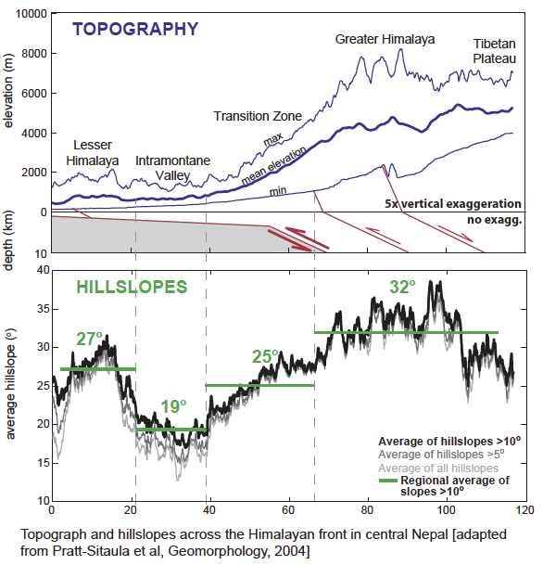
Uses of DEMs
Large-scale geomorphology
(of central Nepal)
Fielding et al., 1994
Notes:
DEMs can be very useful for a variety of landscape analyses. Here a DEM from central Nepal is used to generate maximum, mean, and minimum elevation as well as average hillslopes in different tectonic regions.
Image source: Beth Pratt-Sitaula (adapted from Pratt-Sitaula et al, 2004. Landscape disequilibrium on 1000–10,000 year scales Marsyandi River, Nepal, central Himalaya. Geomorphology, 58, 223 – 241.) http://www.researchgate.net/profile/Arjun_Heimsath/publication/222646165_Landscape_disequilibrium_on_100010000_year_scales_Marsyandi_River_Nepal_central_Himalaya/links/0912f50d9efb97242c000000.pdf

Slide 7
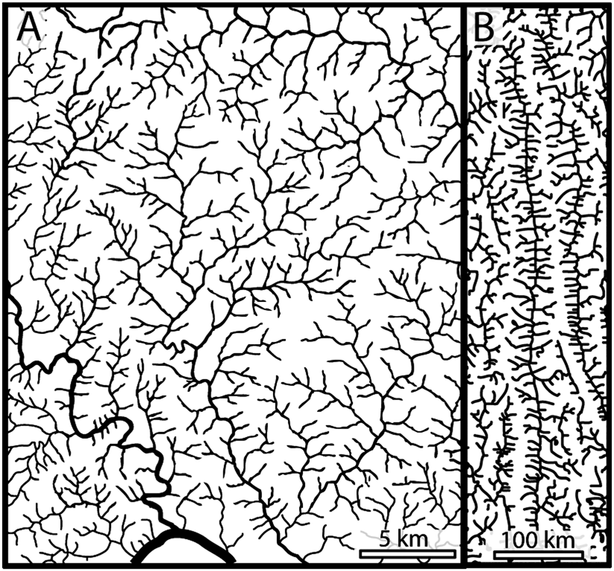
Uses of DEMs
Drainage analysis
ica.usgs.gov
Notes:
Example of two different types of drainage patterns determined from tracing stream networks from traditional topographic maps. Drainage analyses can be done very efficiently using DEMs.
Taken from Roy, S.G., Koons, P.O., Upton, P., and Tucker, G.E., 2015, The influence of crustal strength field on the patterns and rates of fluvial incision, Journal of Geophyscial Research: Earth Surface, 120, doi:10.1002/2014JF003281.
American Geophysical Union allows for use of a journal article image for use in non-commercial educational applications. http://publications.agu.org/author-resource-center/usage-permissions/
Copyright is retained by AGU.
Figure 1. (a) Hydrographic map of a dendritic drainage network, region
east of Palmyra, VA (37.861°N, 78.2633°W). Channels traced from
Palmyra quadrangle, Virginia, 1:24,000, 7.5 min series, Washington D.C.,
USGS, 1897; see also Zernitz [1932]. (b) Hydrographic map of the
drainage network around part of the Salween River, eastern Himalayan
Syntaxis (26.7259°N, 98.8973°E). Channels in Figure 1a formed in largely
homogeneous rock, while those in Figure 1b formed amid several
steeply dipping tectonic structures striking due north [Liu et al., 2011].

Slide 8
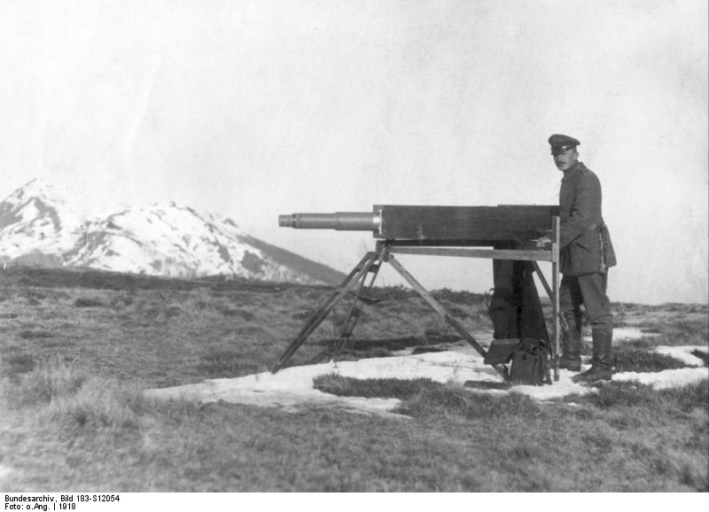
Mapping topography
Original phase of topographic mapping using planetables, clinometers and triangulation
Superceded by precise aerial photo surveys in the 1930s
Augmented by satellite imagery and radar in the 1970s
Increase in resolution with lidar in the 2000s
wikipedia.org
Notes:
Topographic mapping has evolved significantly over the last century as it moved from simple map-making to today’s complex toolbox of methods—including LiDAR—to measure high-resolution topography.
Image source: This image was provided to Wikimedia Commons by the German Federal Archive (Deutsches Bundesarchiv) as part of a cooperation project. The German Federal Archive guarantees an authentic representation only using the originals (negative and/or positive), resp. the digitalization of the originals as provided by the Digital Image Archive. https://commons.wikimedia.org/wiki/File:Bundesarchiv_Bild_183-S12054,_Vermessungstruppe_bei_Fernaufnahmen.jpg

Slide 9
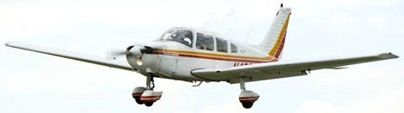
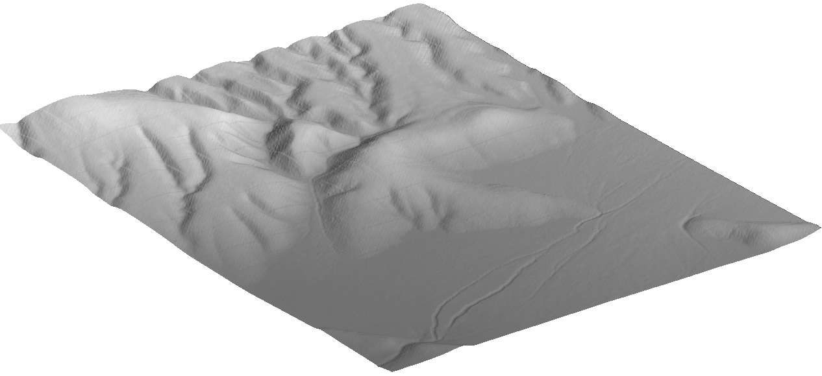
Introduction to Airborne lidar topography
GPS
IMU
Altitude
600 – 1000 m AGL
Swath width
up to 1500 m
Wavelength
500 – 1000 nm
Pulse rate
10s – 100s kHz
Footprint
15 – 20 cm
Accuracy
5 – 15 cm vertical
20 – 30 cm horizontal
GPS base station
Notes:
Initial figure in a set of schematic diagrams that show component of airborne LiDAR collection starting with data collection procedure. Basic parameter details given along with linking of onboard navigation and location coupled with ground-based information.
Image source for remaining slides: Unless otherwise noted, remaining images are reused with permission from presentation by Edwin Nissen (Colorado School of Mines) done in collaboration with Ramon Arrowsmith, Srikanth Saripalli, and Aravindhan Krishnan.

Slide 10
“Point cloud” collection of irregularly spaced x, y, z spot heights
early lidar data sets had ~1 point per sq. m
modern data sets have >10 points per sq. m
1 m
1 m
Notes:
Initial data set shown relative to a fixed grid cell of a specified size

Slide 11
“Point cloud” collection of irregularly spaced x, y, z spot heights
early lidar data sets had ~1 point per sq. m
modern data sets have >10 points per sq. m
Digital Elevation binning algorithm converts point cloud into regular grid
define node spacing and search radius
choose mean, distance weighted mean, maximum or minimum
Model (DEM)
Notes:
Point cloud to regularly spaced grid and means of incorporating appropriate data into single grid point

Slide 12
“Point cloud” collection of irregularly spaced x, y, z spot heights
early lidar data sets had ~1 point per sq. m
modern data sets have >10 points per sq. m
Digital Elevation binning algorithm converts point cloud into regular grid
define node spacing and search radius
choose mean, distance weighted mean, maximum or minimum
Model (DEM)
Notes:
Final gridded data set with light-dark scale used to indicate elevation information for each cell

Slide 13
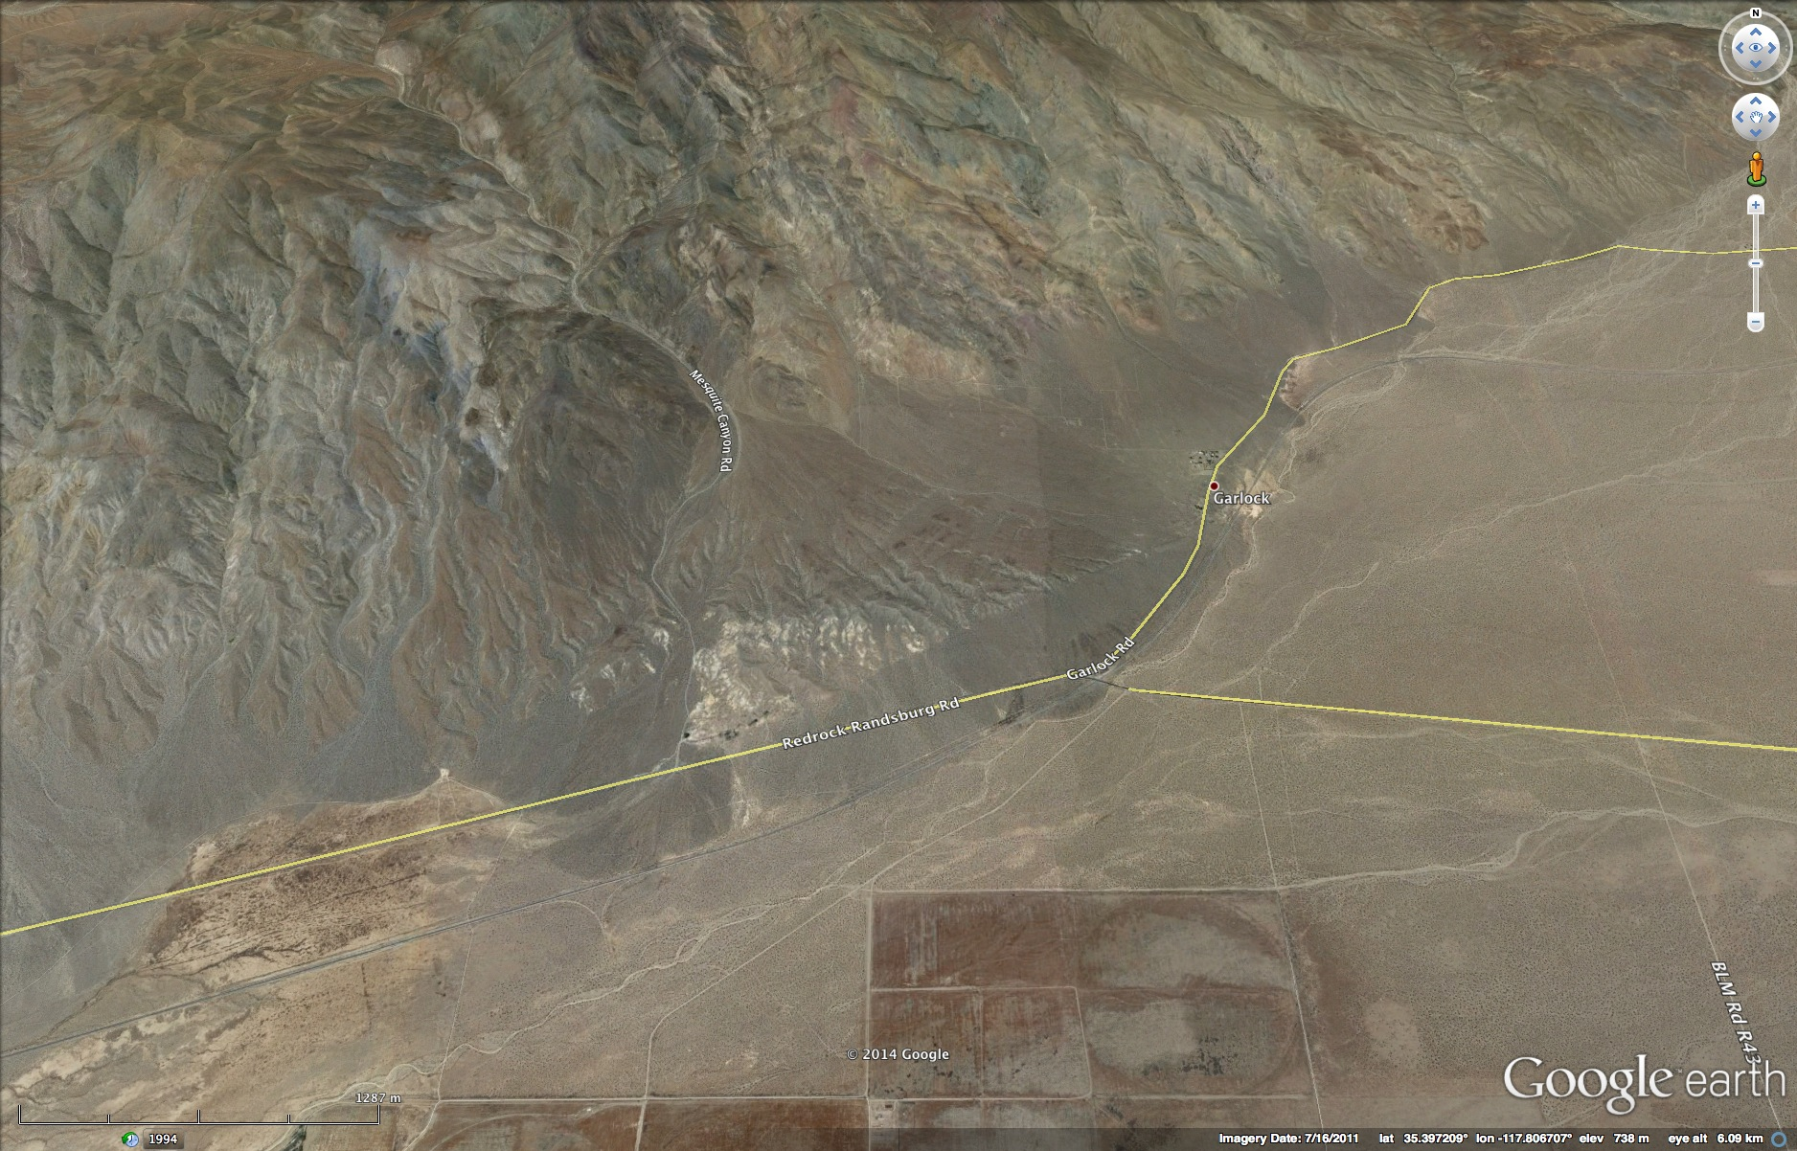
Garlock Fault – Google Earth image
Unit 1: "If an earthquake happens in the desert and no one lives there, should we care about it?" [How are man-made lifelines affected by earthquakes?]
Unit 2: Finding fault(s) with the landscape [Using LiDAR to identify active faults]
Unit 3: How to see an earthquake from space [An introduction to InSAR and its Earth science applications]
Unit 4: Phenomenology of earthquakes from InSAR data [Use of an interactive modeling tool to determine fault slip]
Unit 5: How do earthquakes affect society? [Summative - integration of data sets]
Notes:
The Garlock Fault for the same general locality as indicated by road patterns and railroad line.
Image source: Google Earth

Slide 14
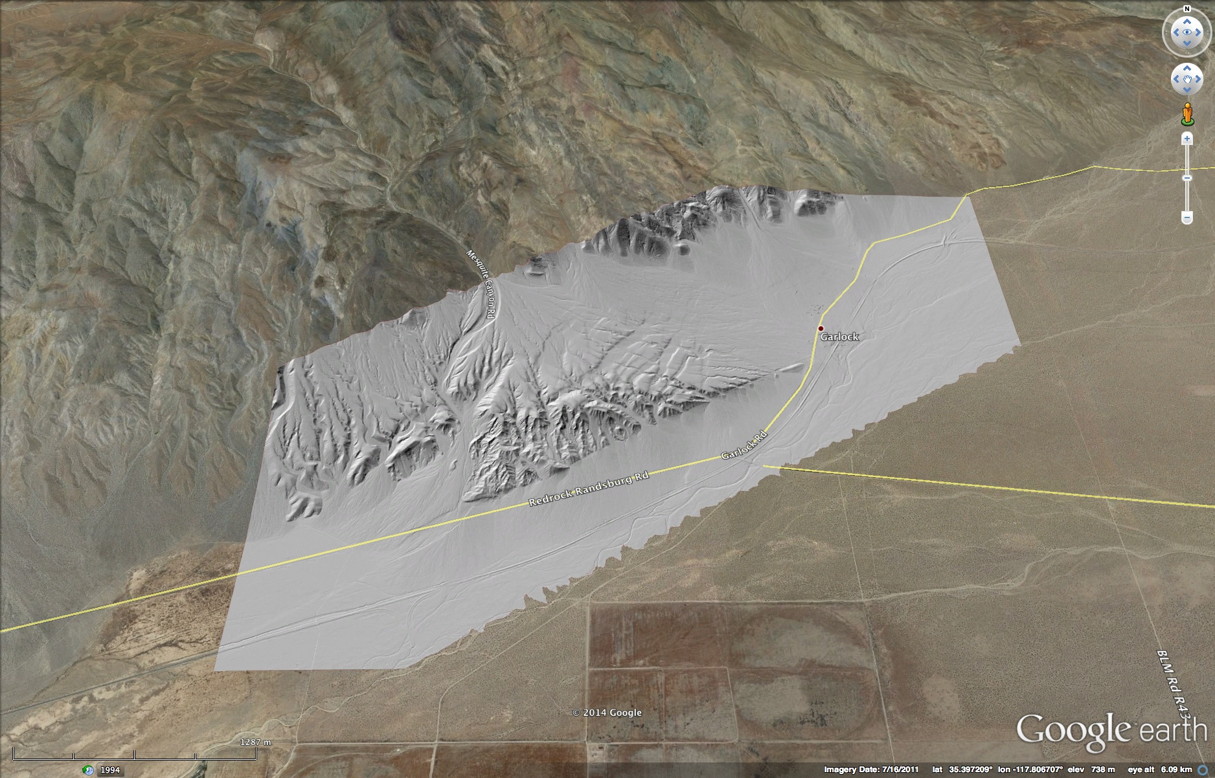
Garlock Fault – Google Earth image + lidar
Unit 1: "If an earthquake happens in the desert and no one lives there, should we care about it?" [How are man-made lifelines affected by earthquakes?]
Unit 2: Finding fault(s) with the landscape [Using LiDAR to identify active faults]
Unit 3: How to see an earthquake from space [An introduction to InSAR and its Earth science applications]
Unit 4: Phenomenology of earthquakes from InSAR data [Use of an interactive modeling tool to determine fault slip]
Unit 5: How do earthquakes affect society? [Summative - integration of data sets]
Airborne lidar KMZ file Overlay
Notes:
Open topography has a large number of data sets. We have selected a subset and organized by fault type
Debate about level of data preparation – raw versus processed
This unit is intended to allow the students to be able to recognize and categorize active faults in the landscape using lidar coupled with other imagery data based a suite of geomorphic features that are created through the interplay of ongoing geomorphic processes that are periodically perturbed by fault displacement.
Example provides a good example from a portion of the Garlock Fault
Image source: underlying image from Google Earth (https://www.google.com/earth/); overlying lidar data from OpenTopography (http://www.opentopography.org/)

Slide 15
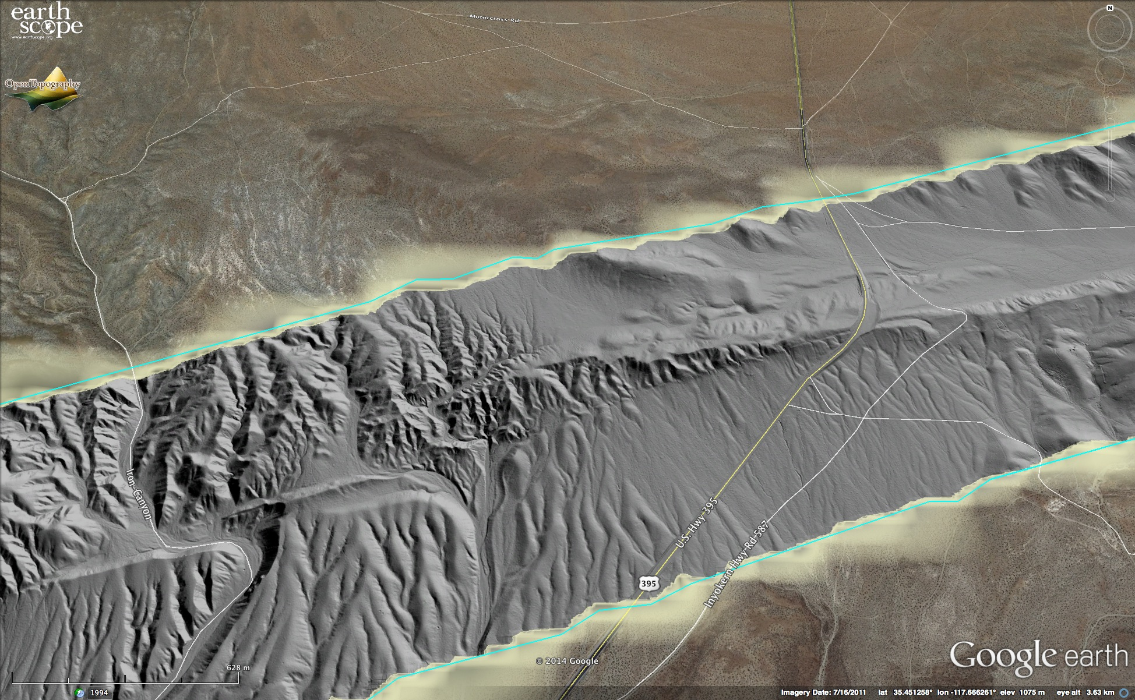
Garlock Fault – Google Earth image + lidar (zoomed in)
Notes:
Quantitative measurements of fault slip document the left lateral displacement across the Garlock Fault.
Stream offsets, stream incision, stream piracy [Note: When measuring using tools available in Google Earth, the lidar overlay is only acting as a visual reference. The measurements are being made using the information in the Google Earth database. For faults with repeated displacement along a relatively stable fault geometry, such as exists for many strike slip and normal faults, the measurements can be reasonably accurate. For fault systems that may have a variable displacement history, such as reverse faults or with a relatively recent scarp, the measurements may not reflect the topographic features visible in the lidar image.]
Rates and evolution of landscape over time
Interplay of tectonic, hydrological, and gravitational processes and their modulation by climatic variation

Slide 16
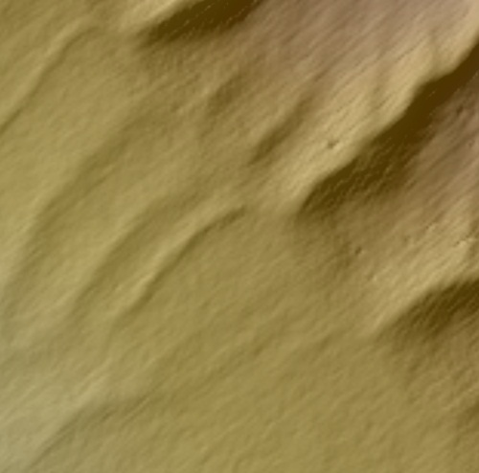
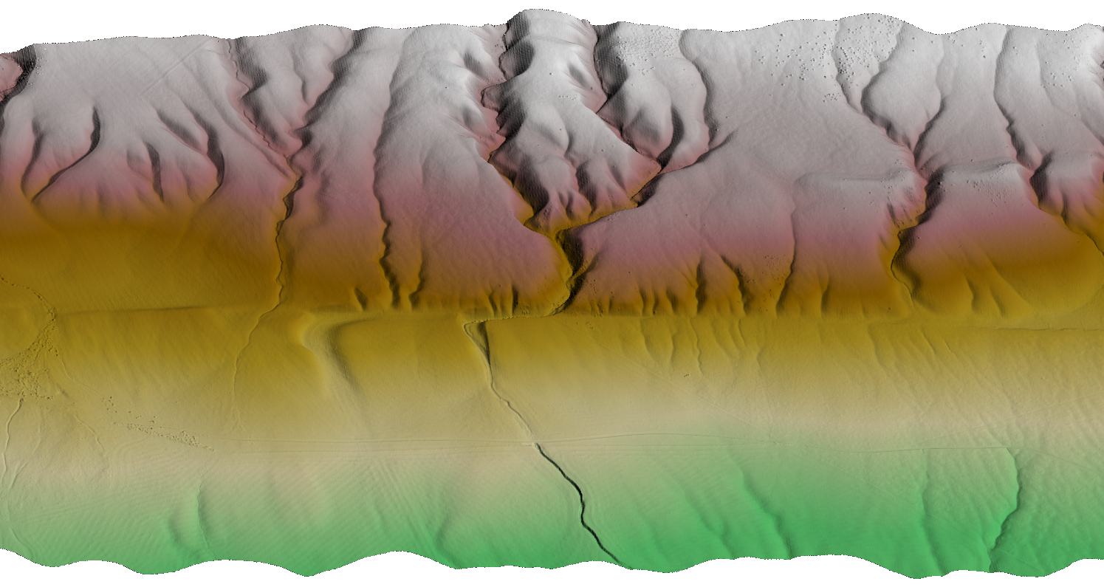
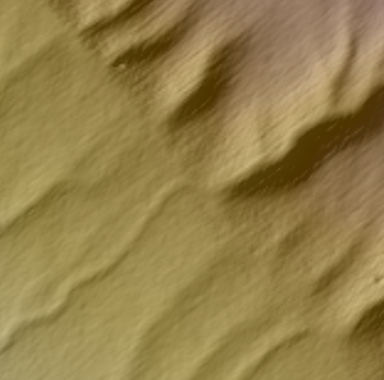
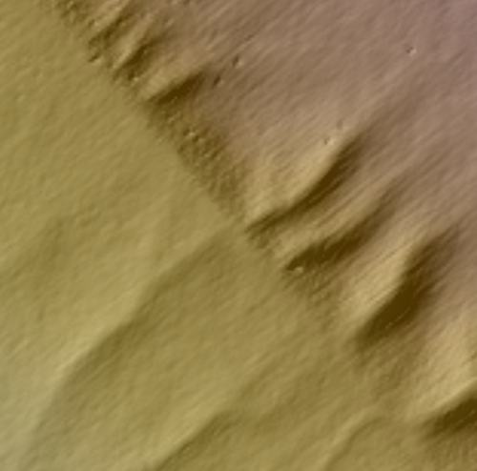
~15 m offset
North American Plate
~10 m offset
Carrizo Plain
~5 m offset
Pacific Plate
Notes:
Example from the San Andreas fault of offset streams

Slide 17
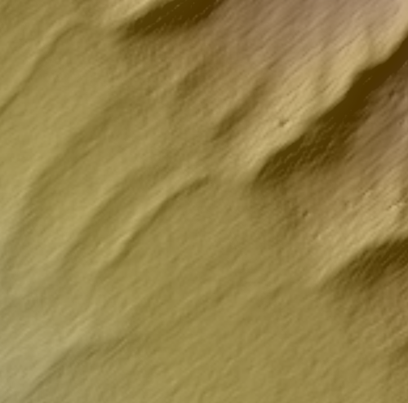
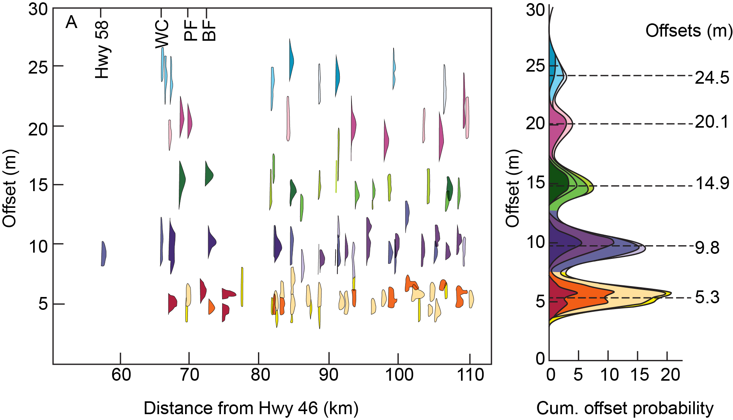
Zielke et al 2010 analysis of stream offsets
~15 m offset
latest 3 eqs
~10 m offset
latest 2 eqs
~5 m offset
1857 earthquake
Notes:
Use of multiple offset stream values to develop a hierarchy of displacement that reflects the passage of time.
Diagram modified from: O. Zielke, J R Arrowsmith, L G Ludwig, and S O Akçiz (2010) Slip in the 1857 and Earlier Large Earthquakes Along the Carrizo Plain, San Andreas Fault.
Science 26 February 2010: 327 (5969), 1119-1122. Published online 21 January 2010 [DOI:10.1126/science.1182781]

Slide 18
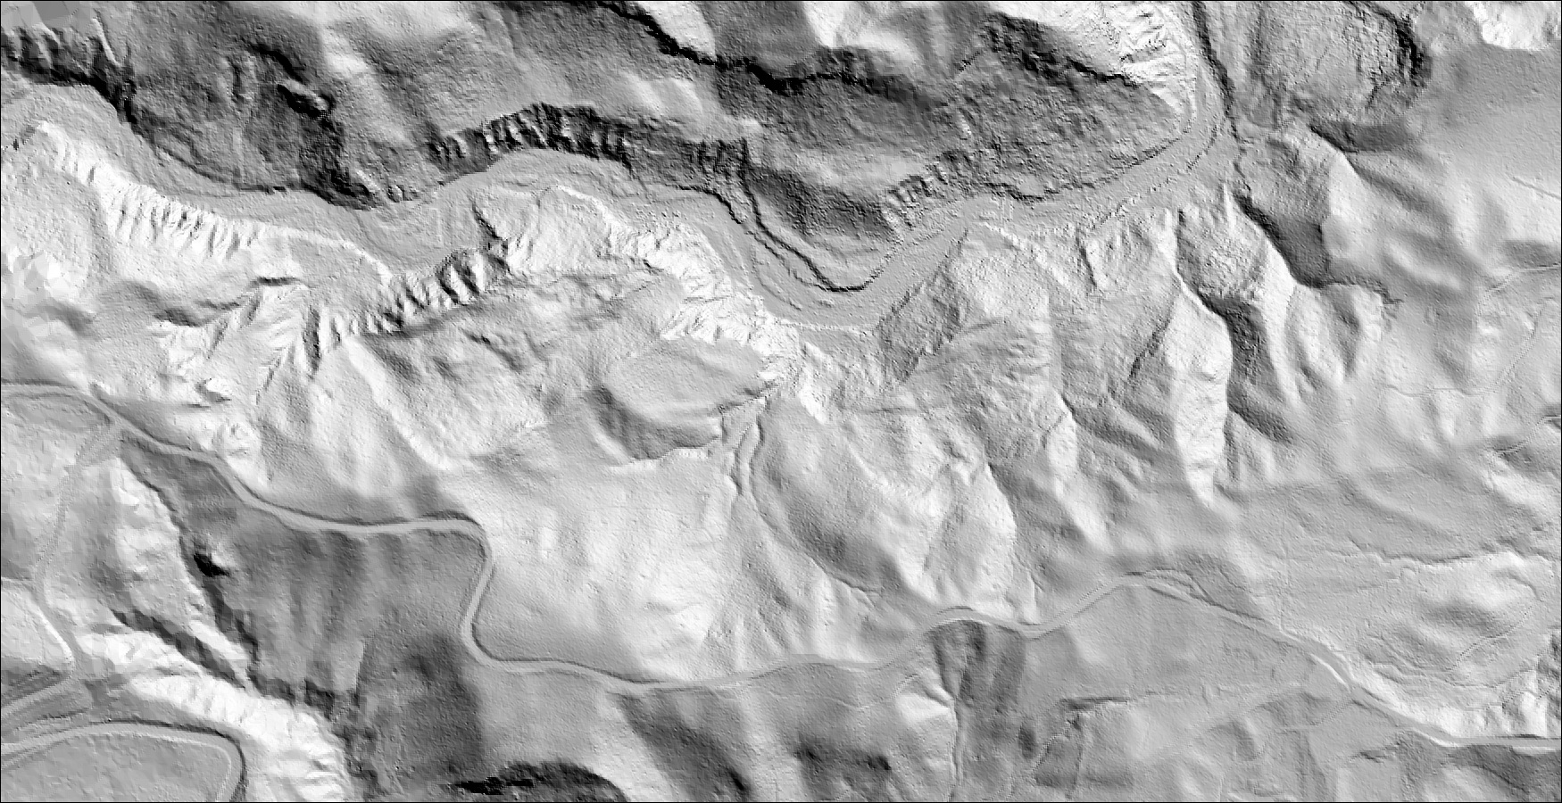
2008 Iwate-Miyagi earthquake (Mw 6.9), Japan
Pre-earthquake DEM (2m)
(data from Edwin Nissen)
Notes:
Fortuitous capture of a before and after sequence documented in lidar images.
Image source: Edwin Nissen.
Learn more about the analysis described here in the article: Nissen, E., Maruyama, T., Arrowsmith, J.R., Elliott, J., Krishnam, A., Oskin, M., and Saripalli, S., 2014. Coseismic faulty zone deformation revealed with differential lidar: Examples from Japanese Mw ~7 intraplate earthquakes, Earth and Planetary Science Letters, 405, 244-256. http://www.sciencedirect.com/science/article/pii/S0012821X14005378

Slide 19
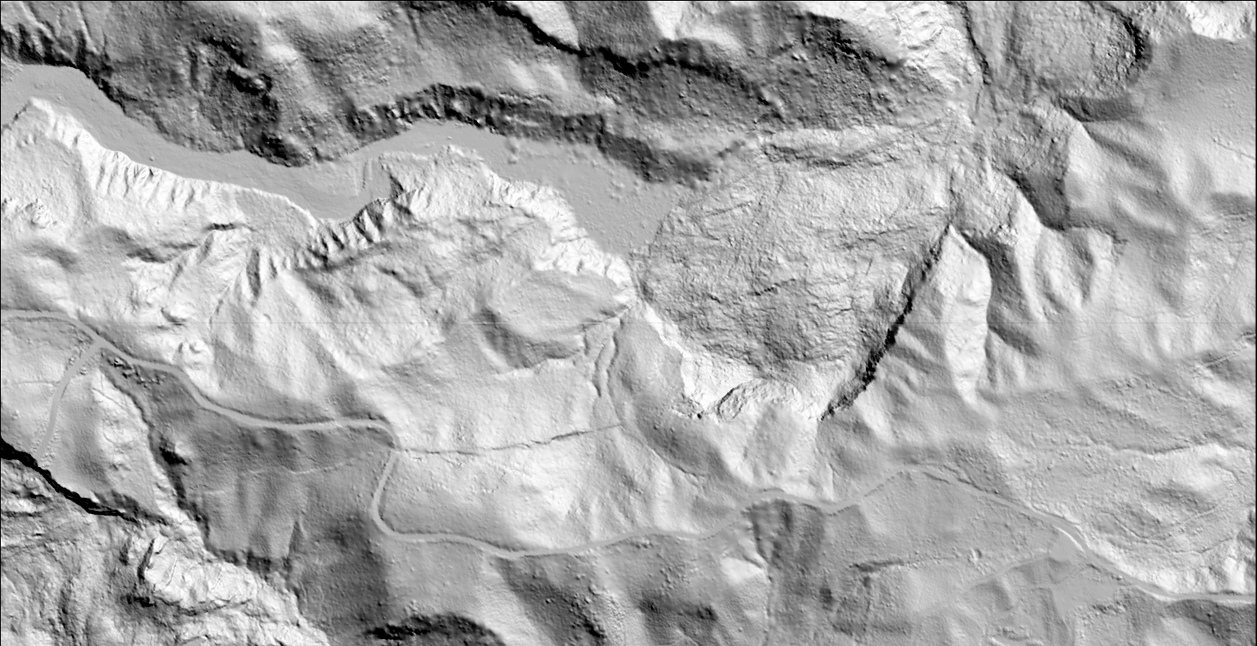
2008 Iwate-Miyagi earthquake (Mw 6.9), Japan
Post-earthquake DEM (1m)
(data from Edwin Nissen)
Notes:
Image source: Edwin Nissen.
Learn more about the analysis described here in the article: Nissen, E., Maruyama, T., Arrowsmith, J.R., Elliott, J., Krishnam, A., Oskin, M., and Saripalli, S., 2014. Coseismic faulty zone deformation revealed with differential LiDAR: Examples from Japanese Mw ~7 intraplate earthquakes, Earth and Planetary Science Letters, 405, 244-256. http://www.sciencedirect.com/science/article/pii/S0012821X14005378

Slide 20
2008 Iwate-Miyagi earthquake (Mw 6.9), Japan
Analysis of change — post-earthquake
dammed sediment
landslide
landslide
(data from Edwin Nissen)

Slide 21
2008 Iwate-Miyagi earthquake (Mw 6.9), Japan
Interpretation
dammed sediment
landslide
landslide
(data from Edwin Nissen)

Slide 22
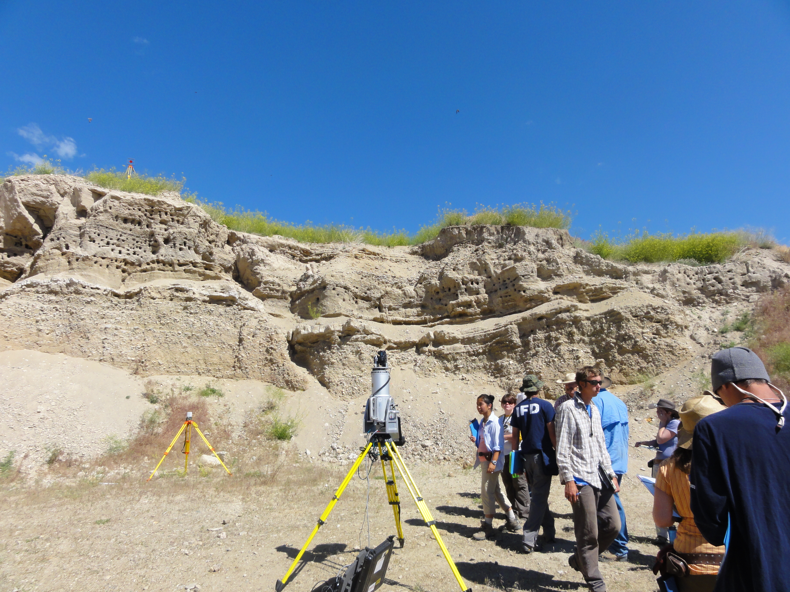
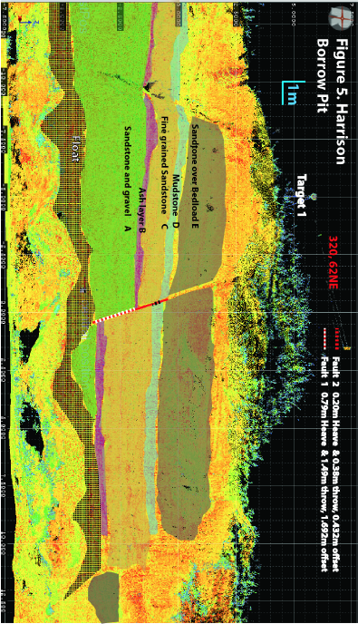
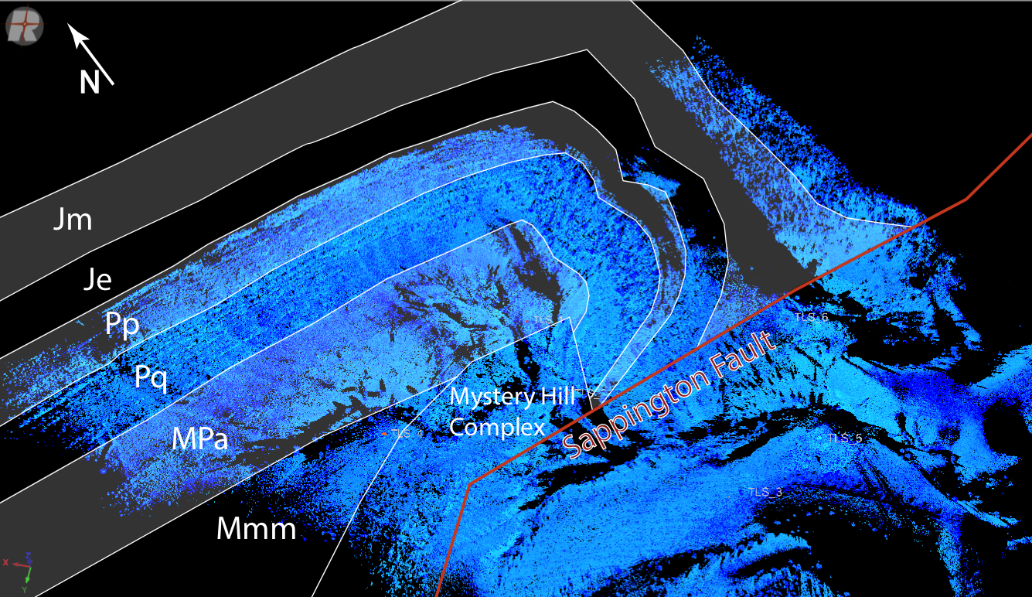
Terrestrial Laser Scanning (TLS)
Lidar units are now available as a tripod-mounted system.
Typically these systems have a range of 500–2000 m.
These can be used to scan outcrops, buildings, fault scarps, volcanoes, landslides, glaciers, beaches . . .
Notes:
Left-hand top and bottom images: show students collecting terrestrial lidar data of a normal fault and an example of the analysis of fault displacement.
Right hand image: A string of multiple terrestrial lidar scans to create a 1-km scale point cloud data set for the purposes of geological mapping and structural interpretation.
Image sources: Bruce Douglas and unavco.org

Slide 23
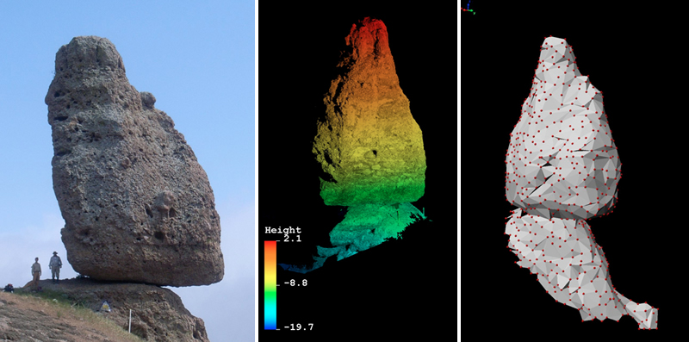
Other TLS applications - Precariously Balanced Rock
unavco.org
Notes:
Another creative use of TLS has been to determine the geometry, mass, and balance points of precariously balanced rocks for paleoseismic studies.
Image source: http://www.unavco.org/highlights/2009/hudnut-pbr.html

Slide 24
Identifying Faults and Fault slip using LIDAR

Slide 25
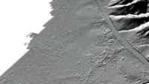
LIDAR – Light Detection and Ranging

Slide 26
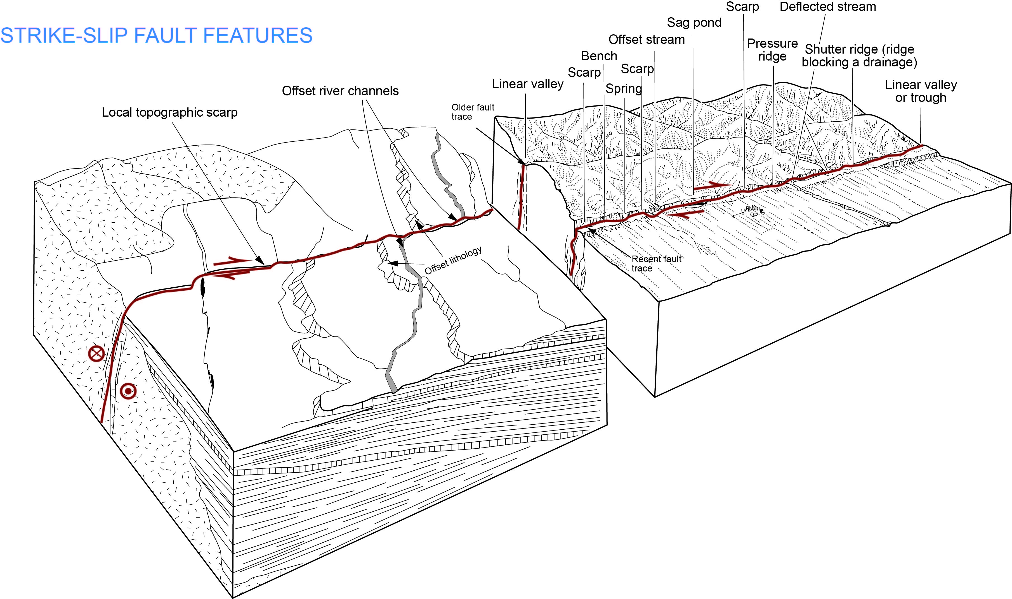
Strike-slip fault features
After Keller & Pinter, Active Tectonics, 2002
Notes:
Figure provides examples of geomorphic/topographic features that are indicative of active strike-slip faulting. While all these features may be present, some are more common than others, and not all would be expected to be found in a single location because some are dependent on the local geologic materials, climate, and human alteration.
Adapted from figures 1.7 and 2.5 from
Keller and Pinter, 2002, Active Tectonics Earthquakes, Uplift, and Landscape, 2nd Edition, Prentice Hall, Upper Saddle River, NJ, 362 pp.

Slide 27
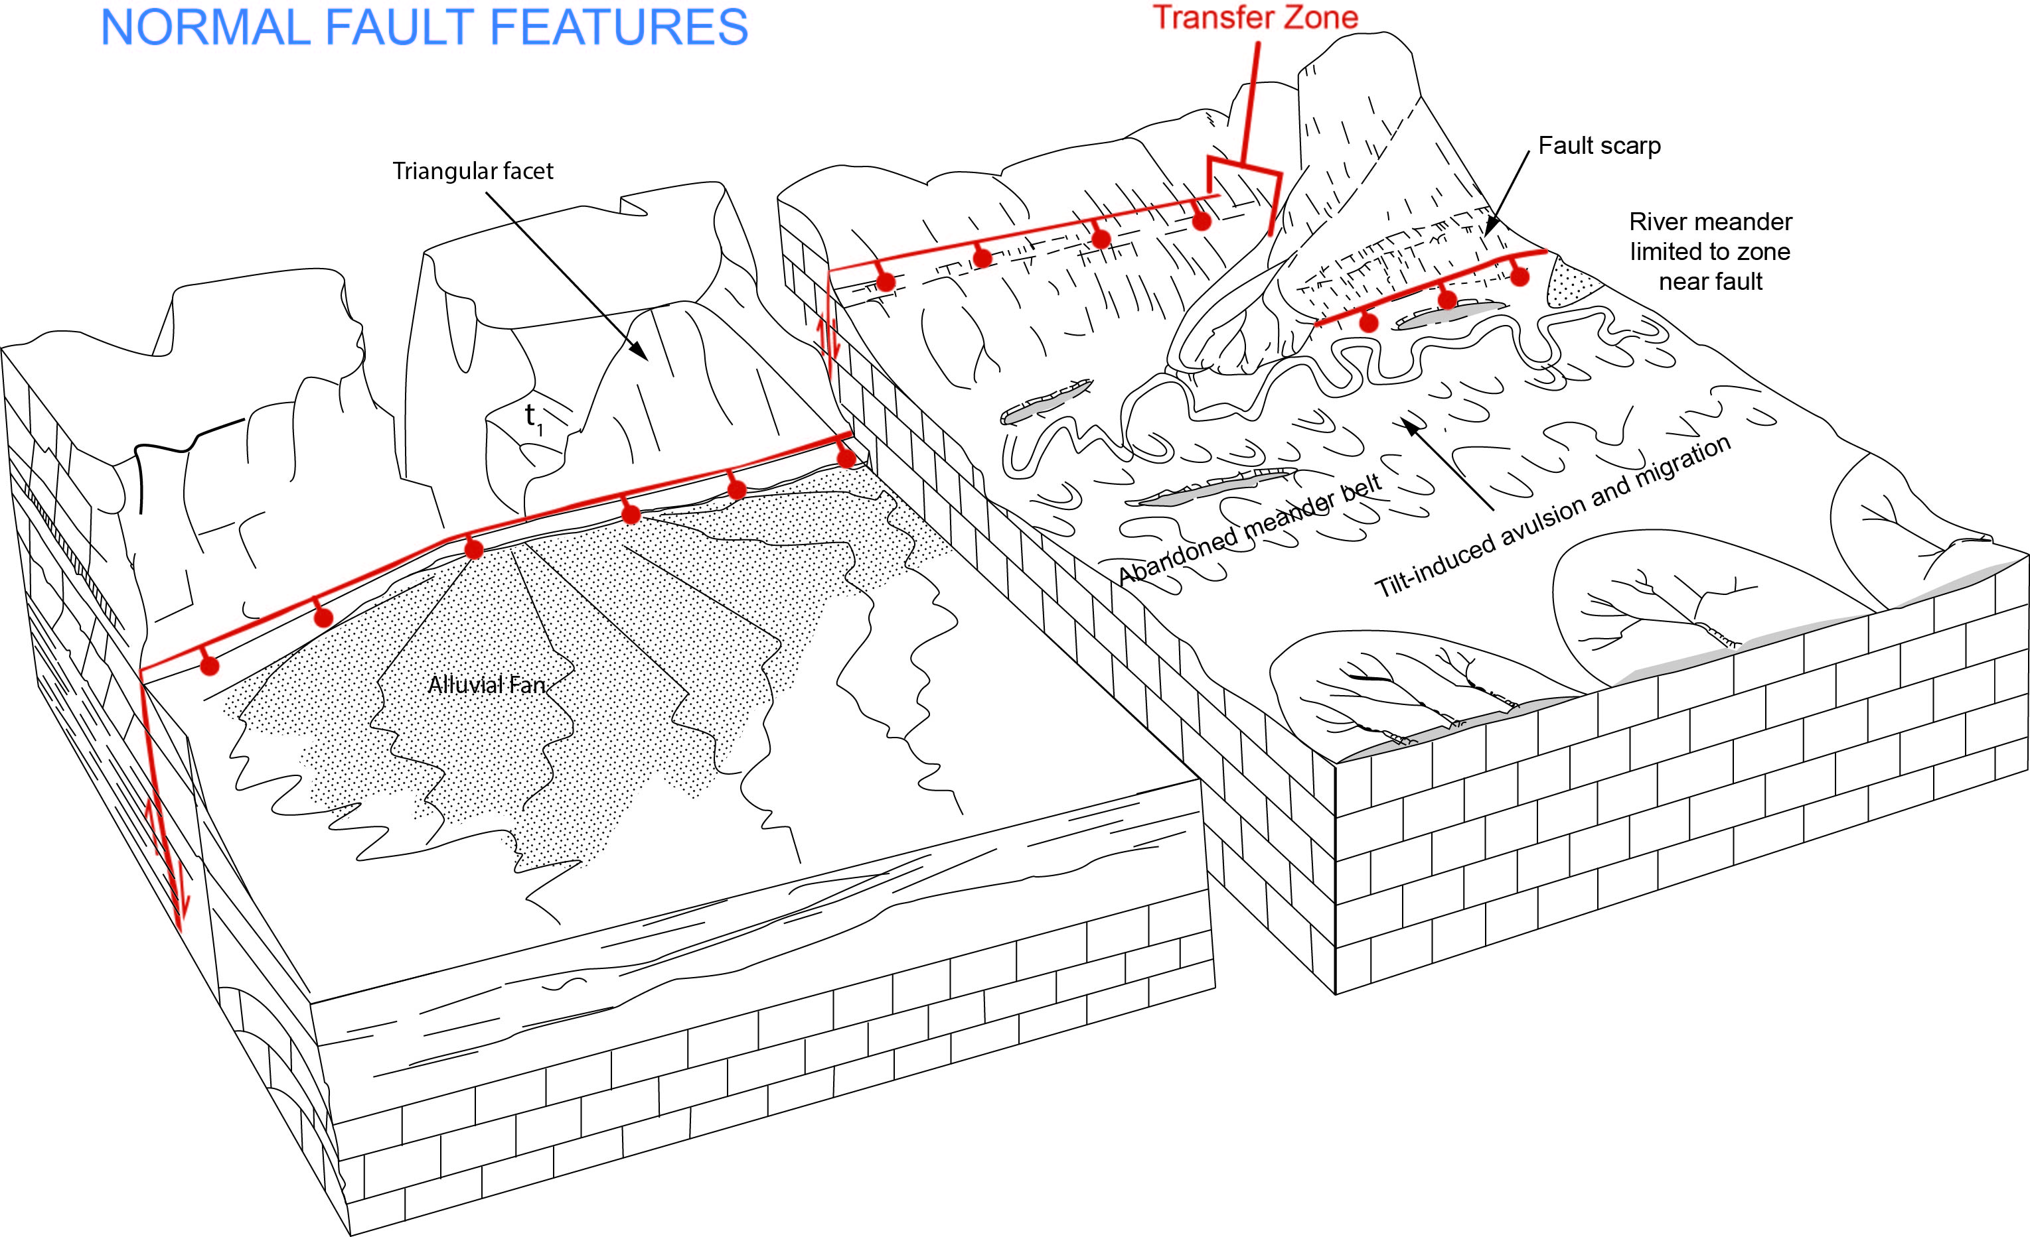
Normal fault features
After Keller & Pinter, Active Tectonics, 2002
Notes:
Figure provides examples of geomorphic/topographic features that are indicative of active normal faulting. While all these features may be present, some are more common than others and not all would be expected to be found in a single location because some are dependent on the local geologic materials, climate, and human alteration.
Adapted from figures 1.7 and 5.17 from
Keller and Pinter, 2002, Active Tectonics Earthquakes, Uplift, and Landscape, 2nd Edition, Prentice Hall, Upper Saddle River, NJ, 362 pp.

Slide 28
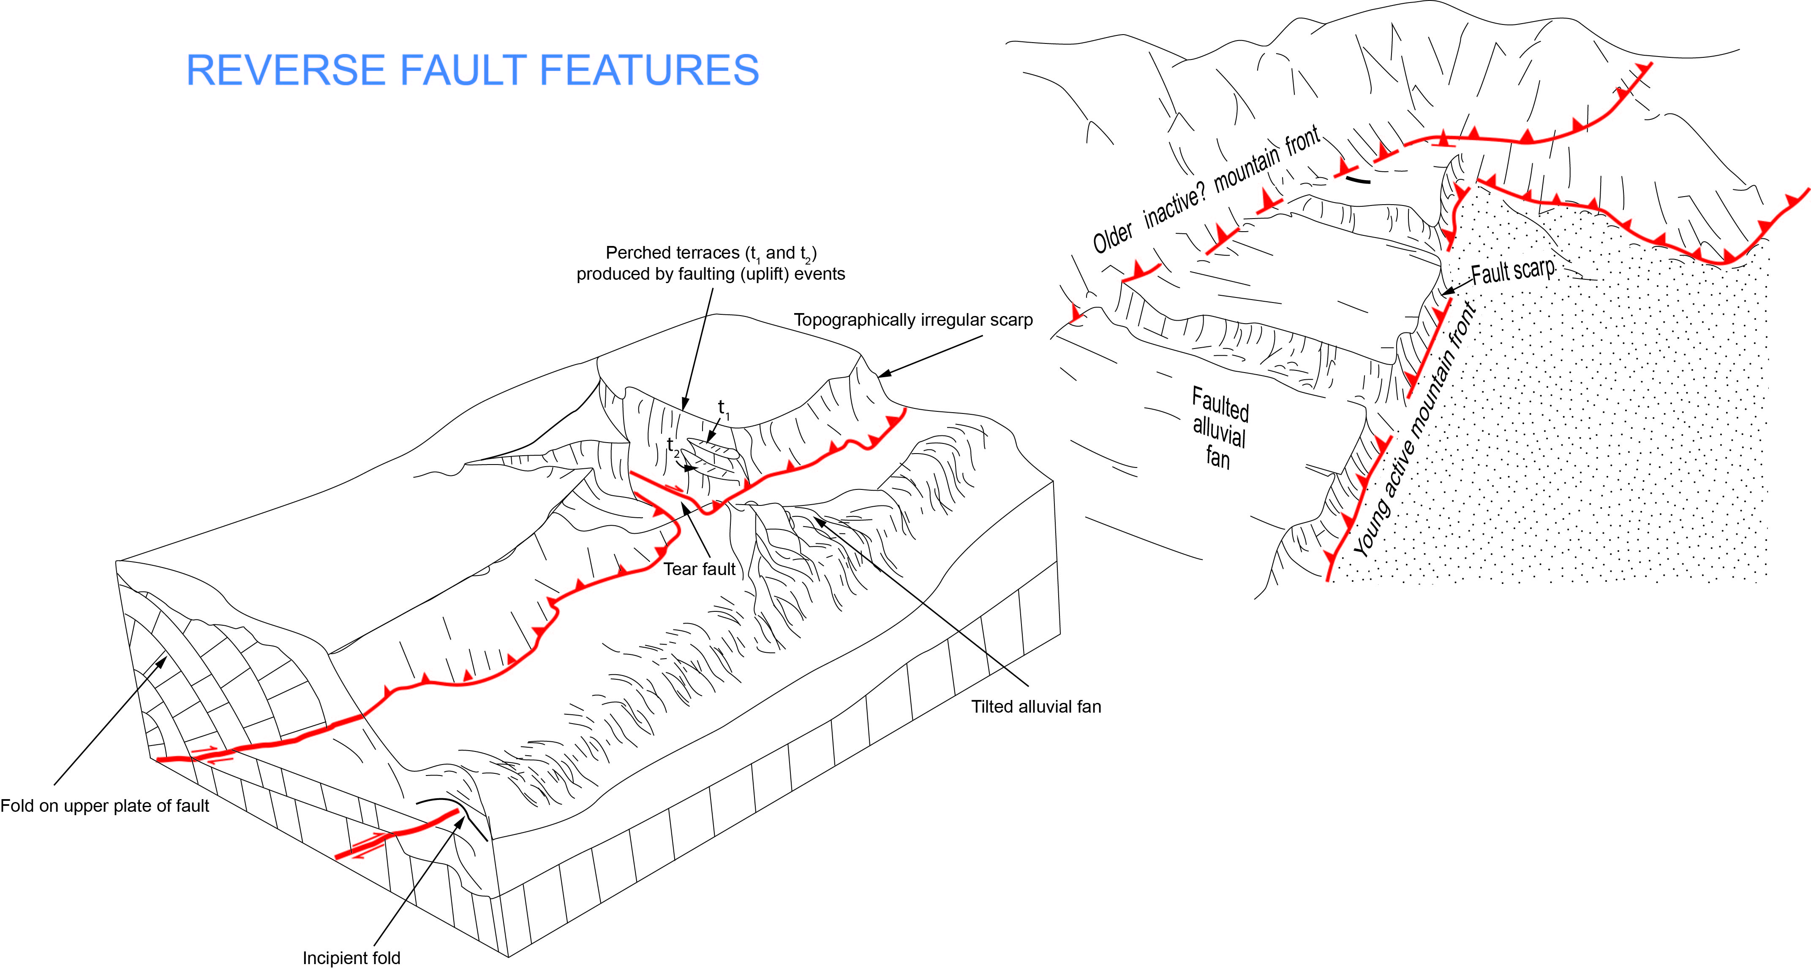
Reverse fault features
After Keller & Pinter, Active Tectonics, 2002
Notes:
Figure provides examples of geomorphic/topographic features that are indicative of active reverse faulting. While all these features may be present, some are more common than others, and not all would be expected to be found in a single location because some are dependent on the local geologic materials, climate, and human alteration. It should be noted that reverse or thrust faults often have the most subtle geomorphic patterns relative to the other fault types. This is due in part to the potential for low to no scarp relief created by a single slip event.
Adapted from figures 1.7 and 4.28 from
Keller and Pinter, 2002, Active Tectonics Earthquakes, Uplift, and Landscape, 2nd Edition, Prentice Hall, Upper Saddle River, NJ, 362 pp.

Slide 29
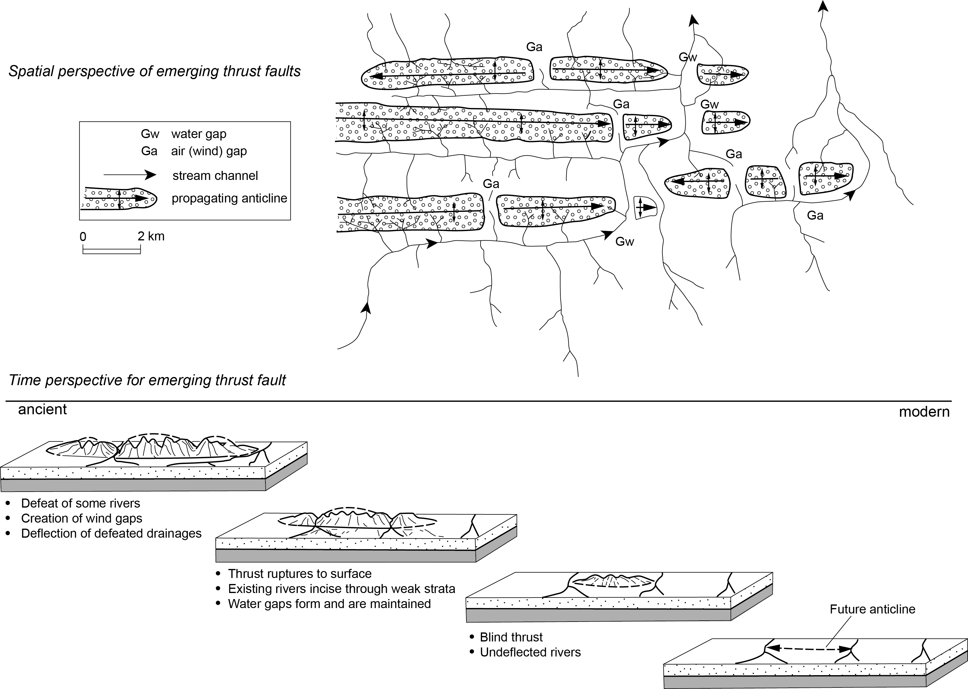
Emergent reverse fault and propagating fold
After Keller & Pinter, Active Tectonics, 2002
Notes:
Figure provides examples of geomorphic/topographic features that are indicative of active reverse faulting. The upper diagram is based on features displayed at Wheeler Ridge in California, where the Wheeler Ridge Fault is extending laterally as well as adding incrementally to the dip slip displacement. This pattern has resulted in what may be interpreted as a time sequence which is shown in the lower diagram. The geomorphic development indicated as ancient reflects a topography that has undergone a number of thrust events whereas the modern diagram reflects conditions prior to initial faulting. While all these features may be present, some are more common than others, and not all would be expected to be found in a single location because some are dependent on the local geologic materials, climate, and human alteration.
Adapted from figures 5.2 and 7.25from
Keller and Pinter, 2002, Active Tectonics Earthquakes, Uplift, and Landscape, 2nd Edition, Prentice Hall, Upper Saddle River, NJ, 362 pp.

